Slide 1
Limits Session 1-2
Course : Calculus
Year : September 2015

Slide 2
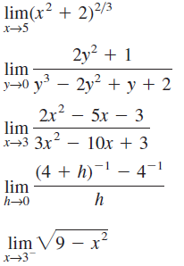
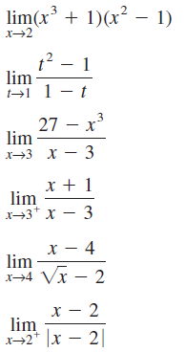
Find the indicated limit if it exists

Slide 3
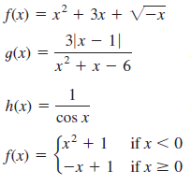
2. Find the numbers, if any, where the function is discontinuous

Slide 4
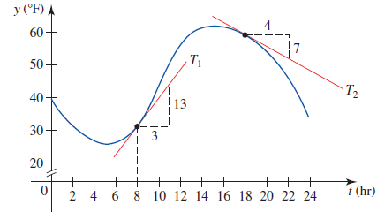
3. Temperature Changes.
The following graph shows the air temperature over a 24-hr period on a certain day in November in Chicago, with t = 0 corresponding to 12 midnight. Using the given data, compute the slopes of the respective tangent lines, and estimate the rate of change of the temperature at 8 A.M. and at 6 P.M.

